Slide 1

MathAlien Project
By Yerassyl Pirzhanov Eskozhanov Baurzhan Sekenov Gabit

Slide 2
Introduction
We decided to choose this project to provide
Well-designed
Handful
Easy to use
Adaptive
Website for everyone who desire to take their fate into their own hands.
To get education, worthy of the greatest minds of Ancient Greek…

Slide 3
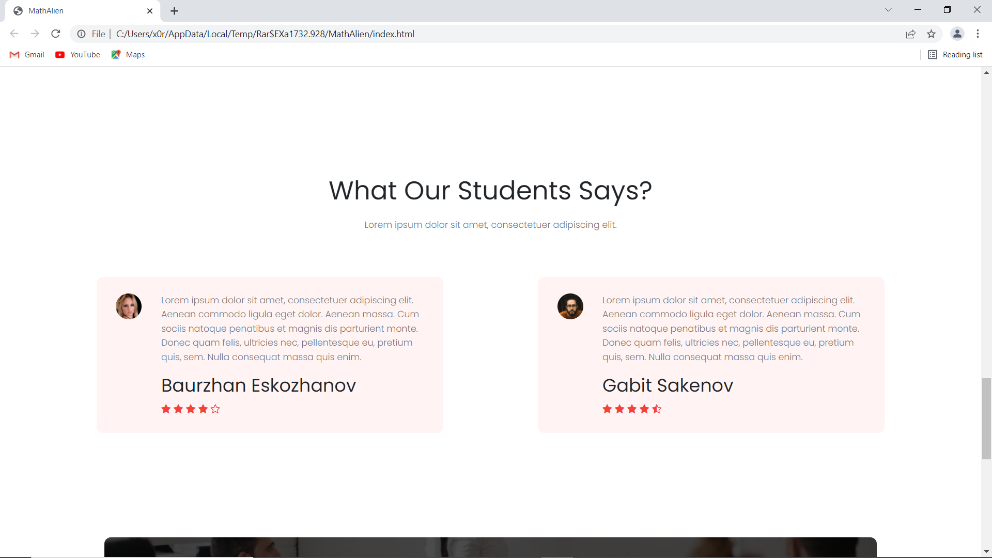
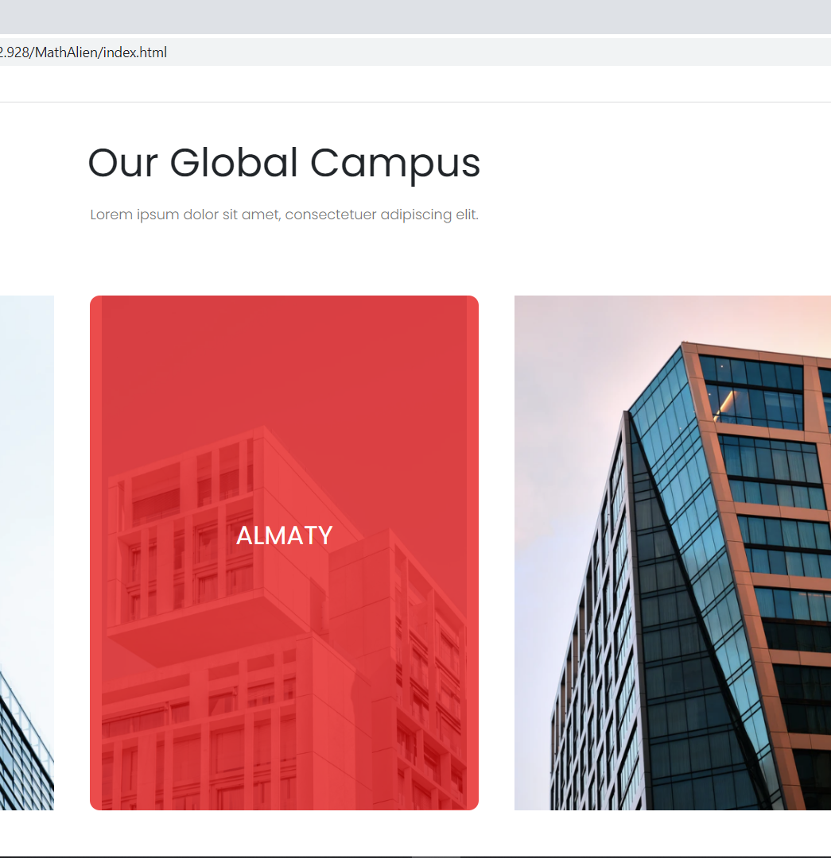
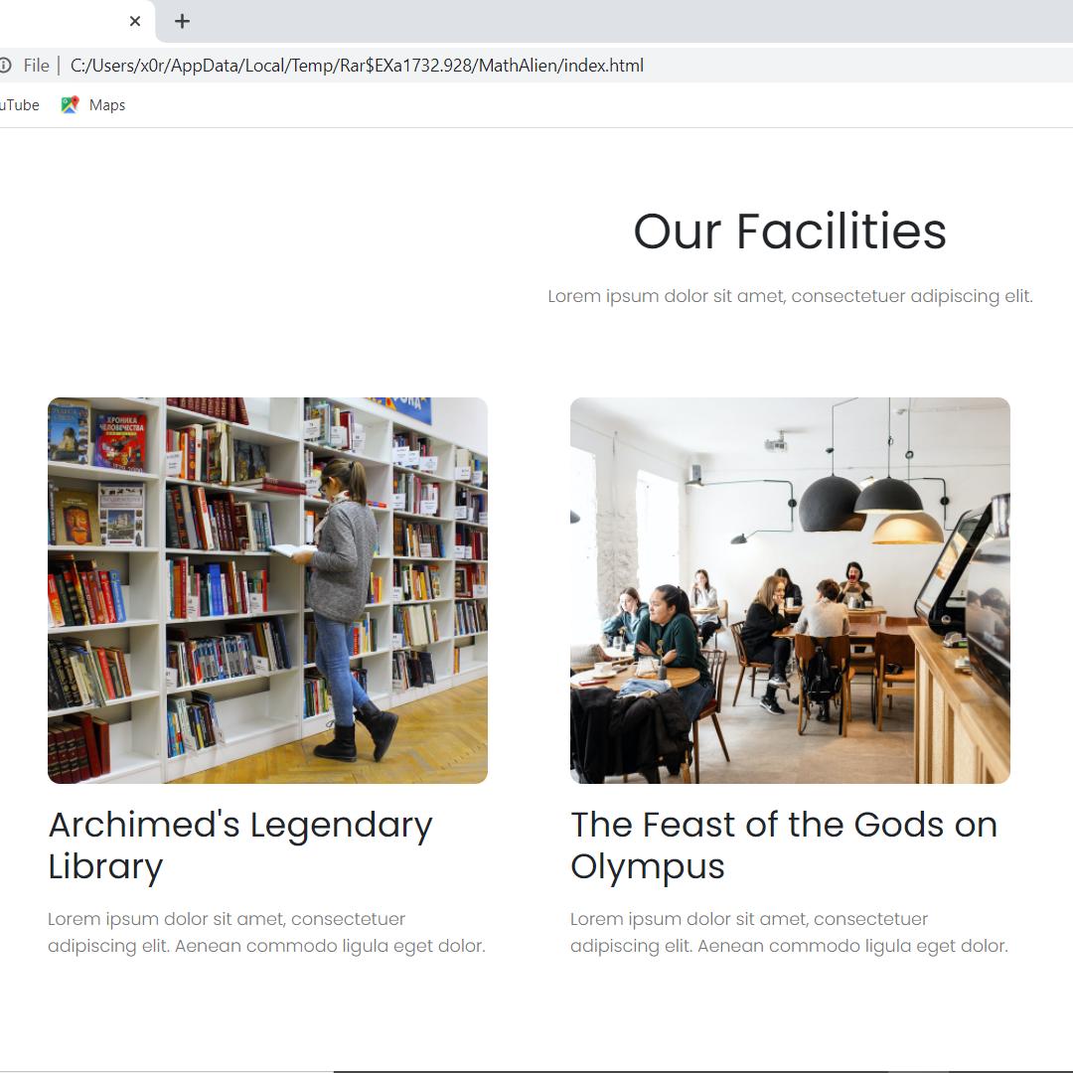
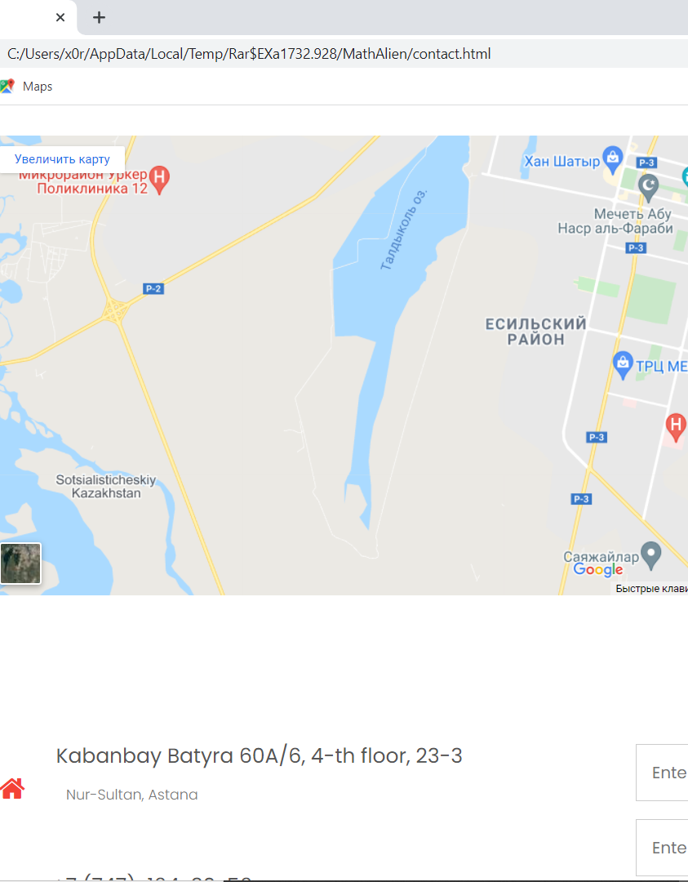
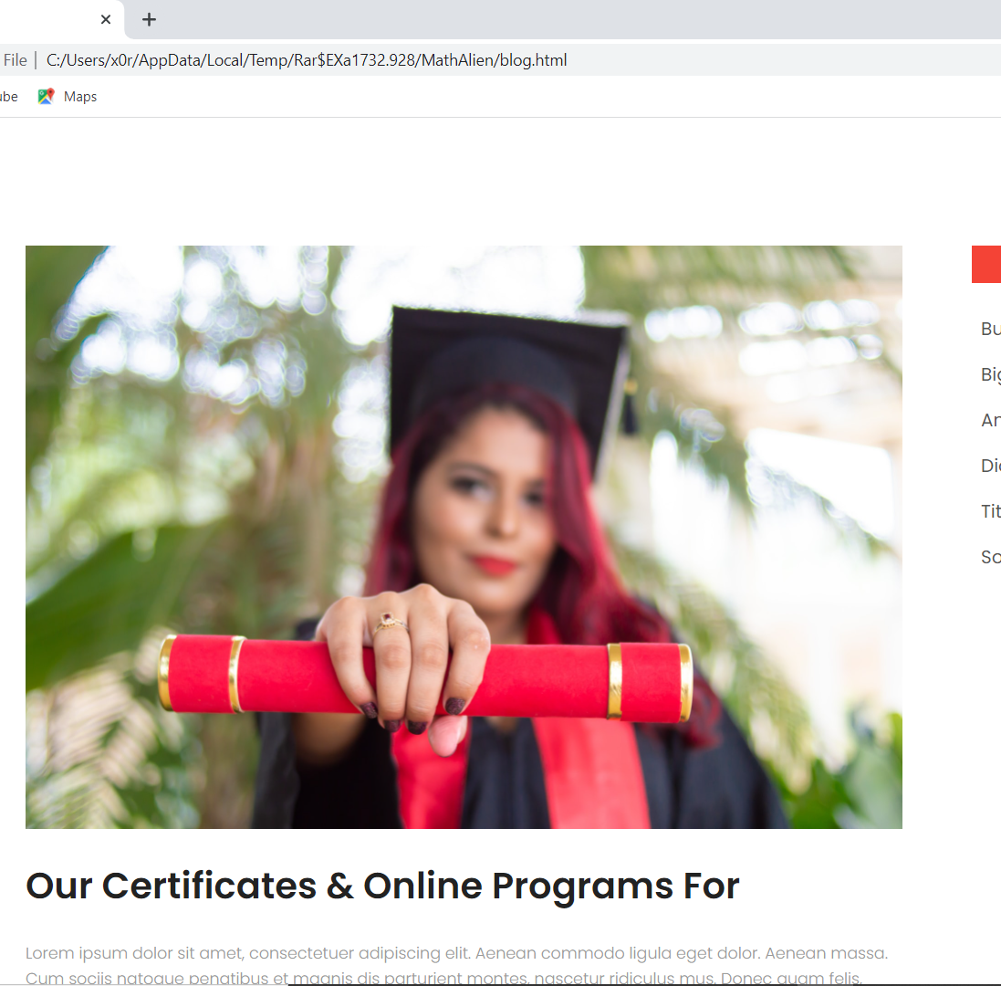
Taking a closer look

Slide 4
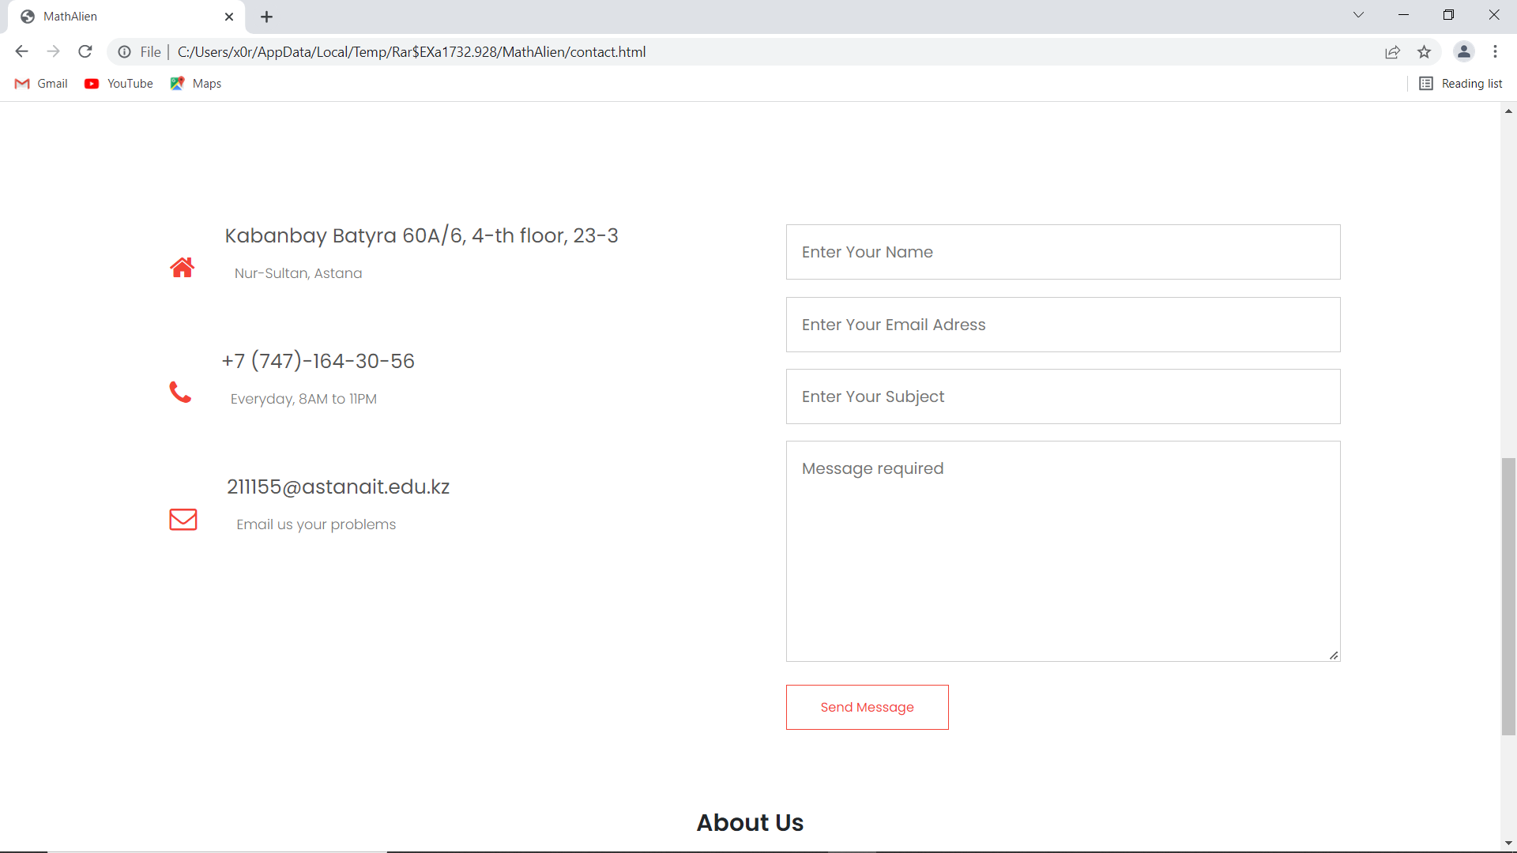
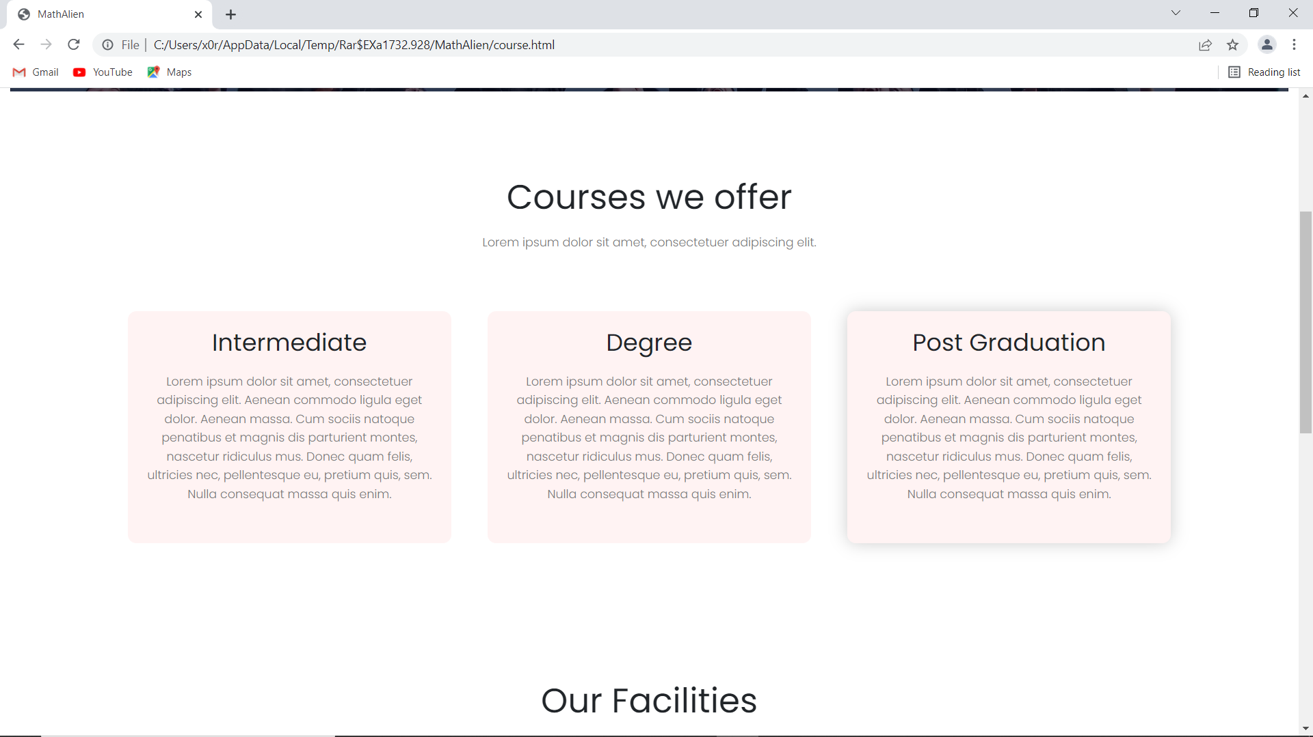
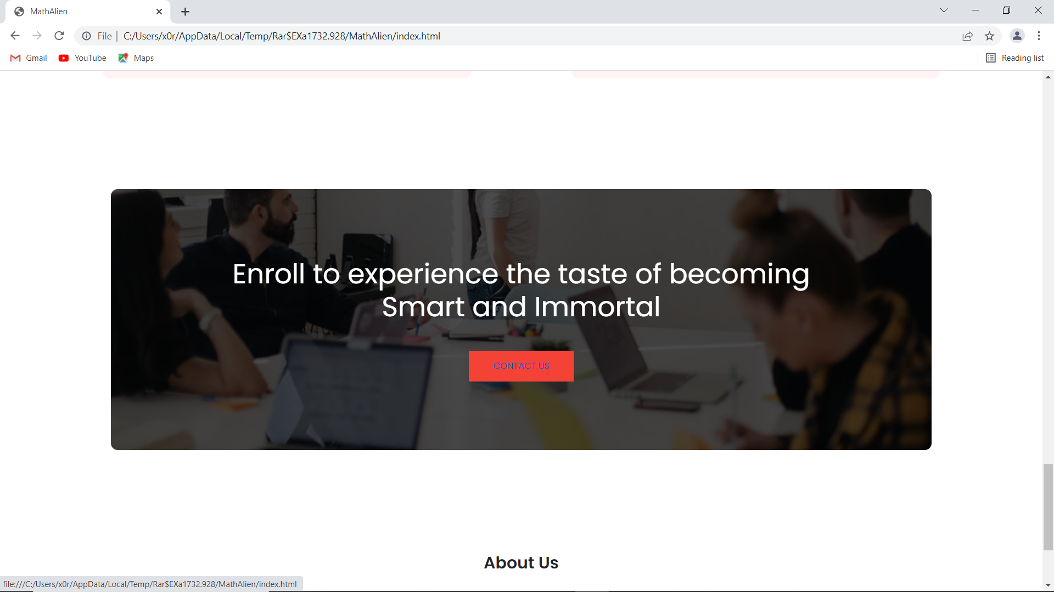
Our courses

Slide 5
Auditory
Students, who seek extra knowledge
Pupils, who wants to enroll
Scholars, who want to expand their horizon
Anyone, who interested in education

Slide 6

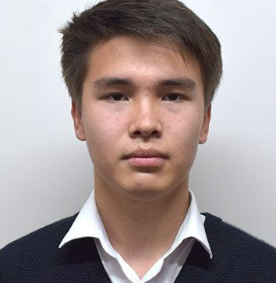
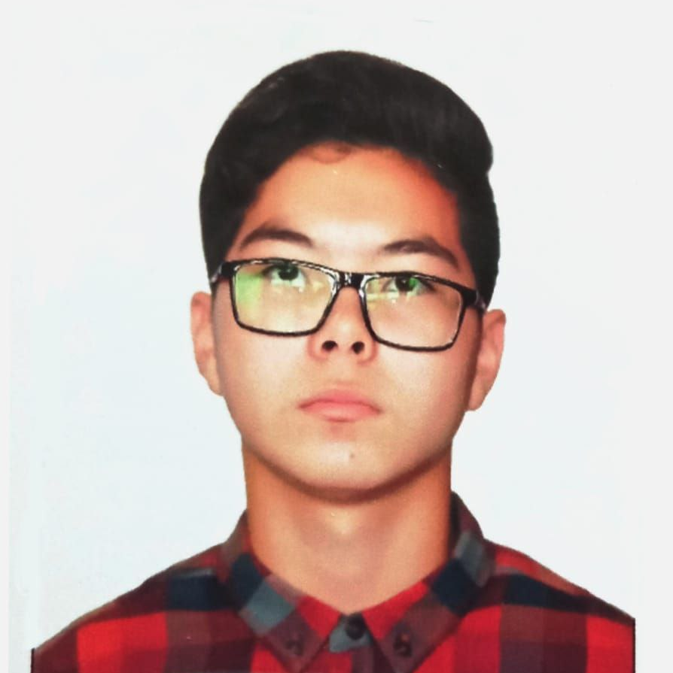
MathAlien Staff
Sakenov Gabit – JS and JQuery expert.
Baurzhan Eskozhanov – UI/UX designer Yerassyl Pirzhanov – Main programmer and TeamLead

Slide 7

Reflection
Briefly, we do believe that MathAlien was a great experience. We made mistakes a lot, lacked ideas, BUT through our sheer will, we managed to fix all the technical issues, created new ideas and most importantly – gained valuable knowledge.

Slide 8
Thank you

